Slide 1
Capacitive Voltage conversion
On Chip DC-DC conversion
Jan Genoe
February 2022

Slide 2
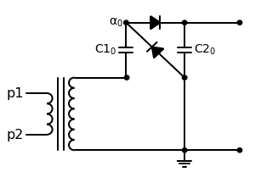

Slide 3
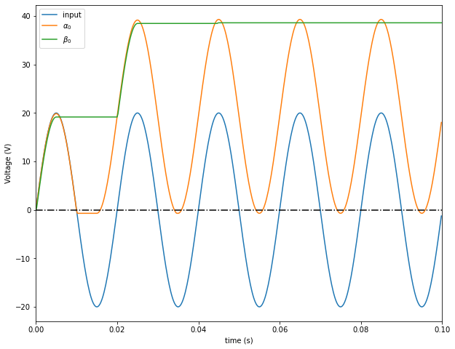

Slide 4
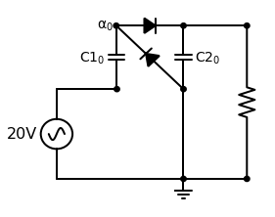

Slide 5


Slide 6
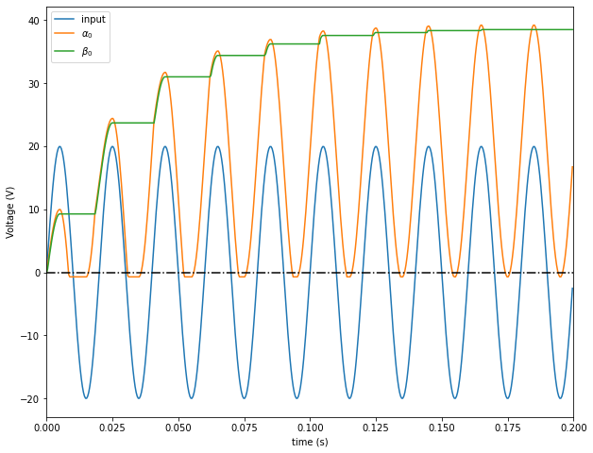

Slide 7
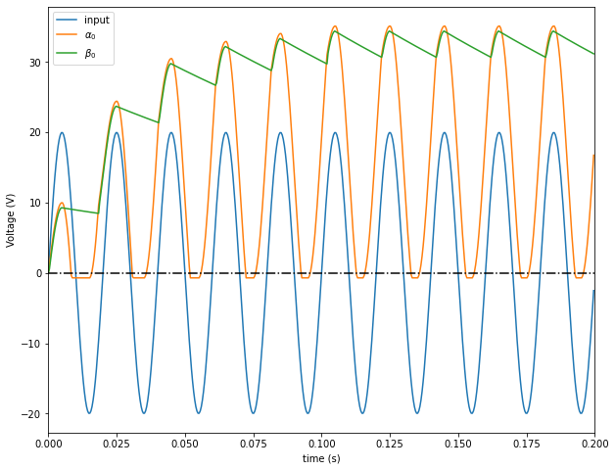

Slide 8
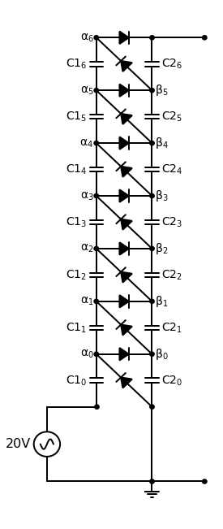

Slide 9
